Slide 1


UCS2201 Fundamentals And Practice Of Software Development
PROJECT PRESENTATION

Slide 2
Engineering Joint Seat Allocation

Slide 3
TEAM MEMBERS
Sweety Y 3122 22 5001 146
Varsha G 3122 22 5001 152
Vishnu Praba A 3122 22 5001 164
Yuvapriya N 3122 22 5001 167

Slide 4
PROBLEM STATEMENT
Develop a software system for the engineering counselling and admission process for two sets of institutes (for example, say IITs and NITs) each having a set of different branches, each branch with a certain number of seats available.
Number of candidates can be assumed as 5 times the total number of seats available. Each candidate can provide a list of preferences where each preference is a 2-tuple, (institute, branch).
Admission to each set of institutes is based on its own qualifying exam (for example, JEE-Advanced and JEE-Main).
Each candidate will have a specific rank in one or both merit lists.

Slide 5
EXTENDED EXPLORATION OF PROBLEM STATEMENT
In the case of a single merit list, candidates are arranged in a sequential order based on their ranks. Seat allotment is then performed by going through the list in order and allowing each candidate to select from the available seats.
However, the situation becomes more complex when dealing with multiple merit lists, such as those for IITs, NITs, and other institutions that require an additional examination for admission. In this scenario, candidates need to create a common choice list across these multiple merit lists.
The challenge arises when there are many candidates, possibly in the hundreds of thousands, who must prioritize and select their preferred options from these different merit lists. The system requires robust algorithms, efficient data structures, and comprehensive databases to manage the candidates' choices and ensure that each candidate is allotted a suitable seat according to their preferences and ranks.
The Candidate-Proposing Deferred Acceptance (DA) algorithm is a mechanism used in many allocation problems, including school choice and matching markets. In the DA algorithm, candidates propose to their preferred options, and institutions provisionally accept the best candidates, iteratively improving the matches until stable allocations are achieved.

Slide 6
INDIVIDUAL CONTRIBUTION
TEAM MEMBER NAME: SWEETY Y
MODULES WORKED:
DATA BASE MODULE
TEAM MEMBER NAME: VARSHA G
MODULES WORKED:
COLLEGE LOGIN MODULE,INTEGRATION OF MODULES
TEAM MEMBER NAME: VISHNU PRABA A
MODULES WORKED:
MAIN MODULE,INTEGRATION OF MODULES
TEAM MEMBER NAME: YUVAPRIYA N
MODULES WORKED:
STUDENT LOGIN MODULE

Slide 7
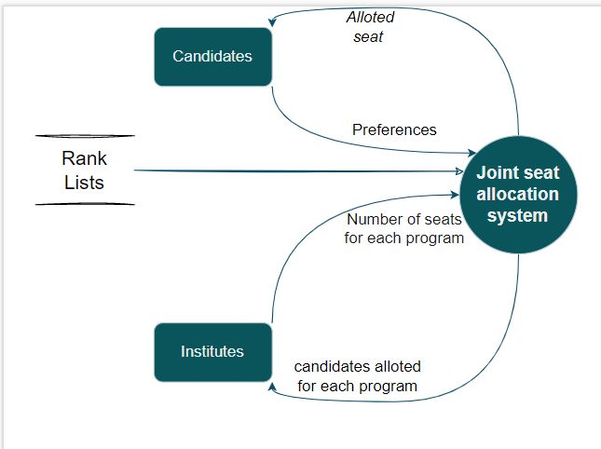
ANALYSIS USING DATA FLOW DIAGRAMS
LEVEL 0

Slide 8
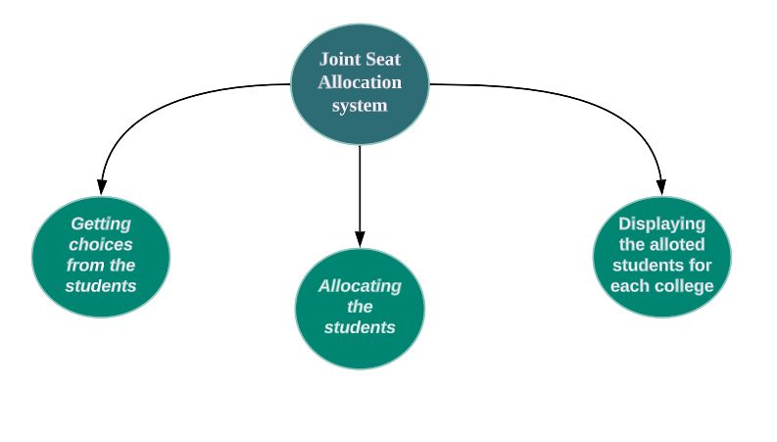
LEVEL 1

Slide 9
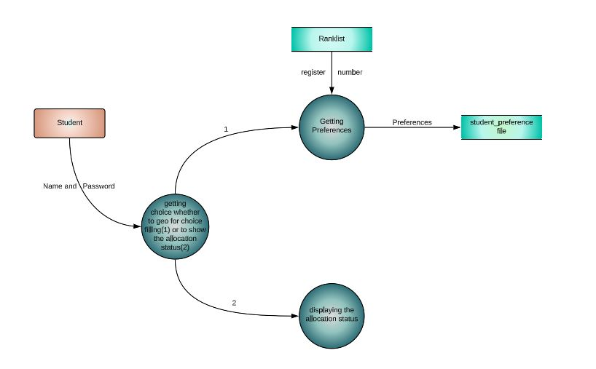
LEVEL 2.1

Slide 10
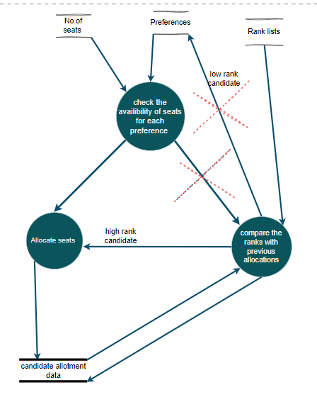
LEVEL 2.2

Slide 11
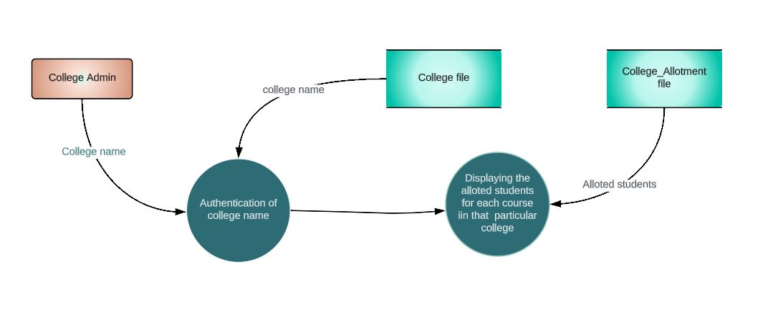
LEVEL 2.3

Slide 12
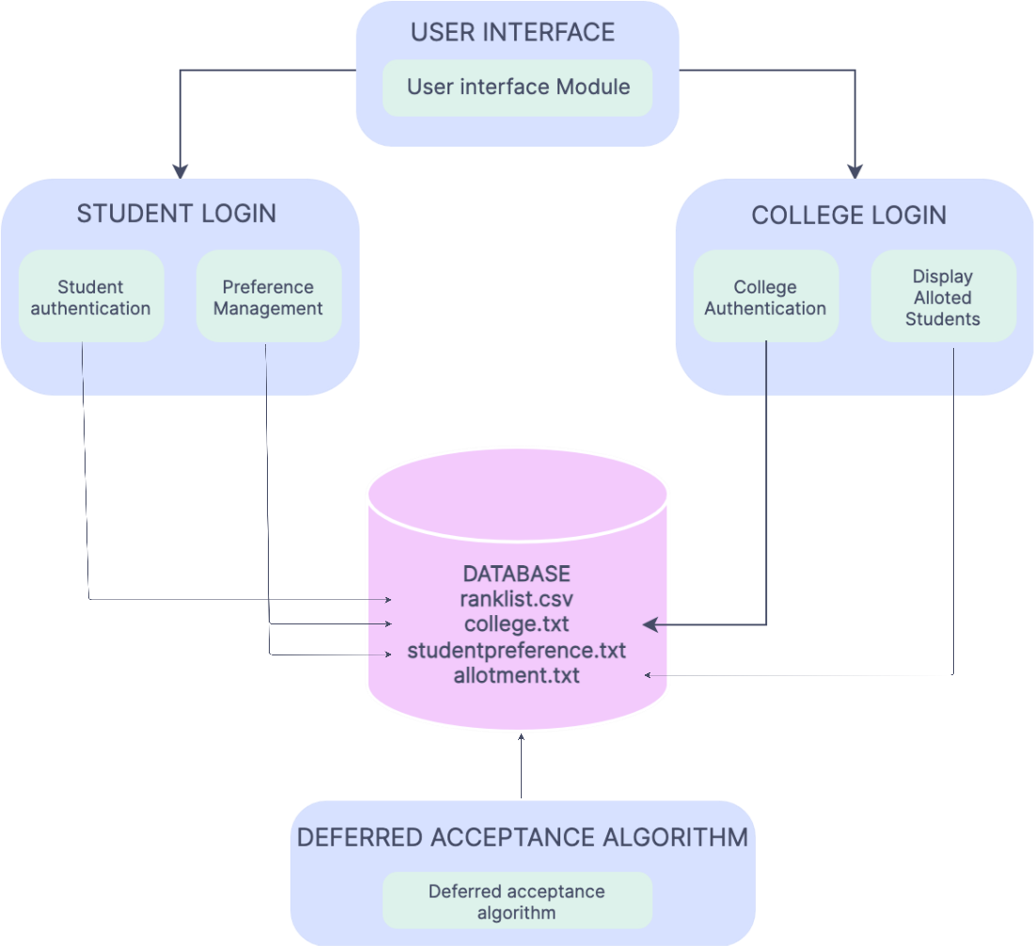
ARCHITECTURAL DESIGN

Slide 13
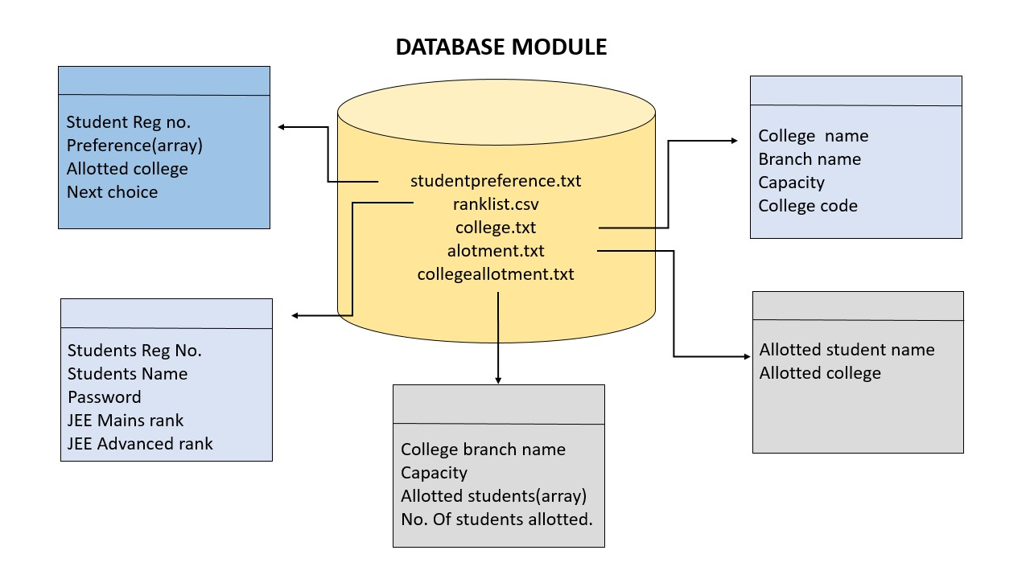
DATABASE MODULE

Slide 14
DATABASE MODULE
studentpreference.txt
Reading Data:
The code includes functions such as ‘no_of_students()’, ‘check_password()’, ‘is_present()’, and ‘check_advanced()’ that read data from files.
no_of_students() read the number of students from the "studentpreference.txt" file.
Data Storage:
Stores
student preference information

Slide 15
Ranklist.csv
Reading Data:
‘check_password()’ reads the “Ranklist.csv” file to check if the entered student’s name and password match.
‘check_advanced()’ reads the “Ranklist.csv” file to check if a student has written the JEE Advanced exam.
File Format:
"Ranklist.csv" is expected to have columns for student names, ranks, and passwords.
Data Storage:
Contains data related to students’ names, ranks, passwords and register numbers.

Slide 16
College.txt
Data Storage:
Contains data related to colleges’ names, branches, capacity and college code.
Reading Data:
‘is_present()’ checks if a given program is present in the “college.txt” file and returns the corresponding program number.

Slide 17
Allotment.txt
Writing Data:
‘write_clg()’ writes the allocated program information to the console.
‘display_allotted_program()’ reads the “Allotment.txt” file to display the allocated program for a given student.
Data Storage:
Stores the allocation details of students.

Slide 18
Collegeallotment.txt
Writing Data:
The algorithm module writes the allotted students as an array and also the number of students allotted to the particular program.
Data Storage:
Stores the allocation details of colleges.

Slide 19
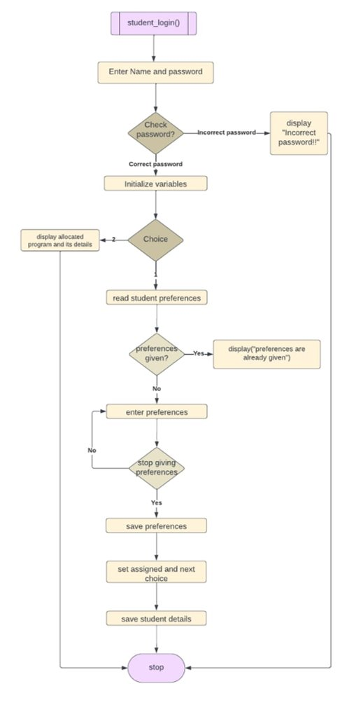
STUDENT_LOGIN() MODULE

Slide 20
STUDENT_LOGIN() MODULE
Read student's name and password as input.
1
Check if name and password match the records using 'check_password'.
2
If match is found, check if student has given preferences by reading from a file.
3
If preferences exist, display a message and set 'prefcheck' flag to 0.
4
If no preferences, prompt the student to choose between filling preferences or allocation.
5
If filling preferences, enter loop to input valid program choices, checking for duplicates.
6
If invalid program, show list of institutes and branches and repeat preference entry.
7
Store student's preferences in the file along with relevant data.
8
If allocation chosen, call 'display_alloted_program' function to show the allocated program.
9
If password match fails, display "Incorrect Name or password!" message and exit.
10

Slide 21
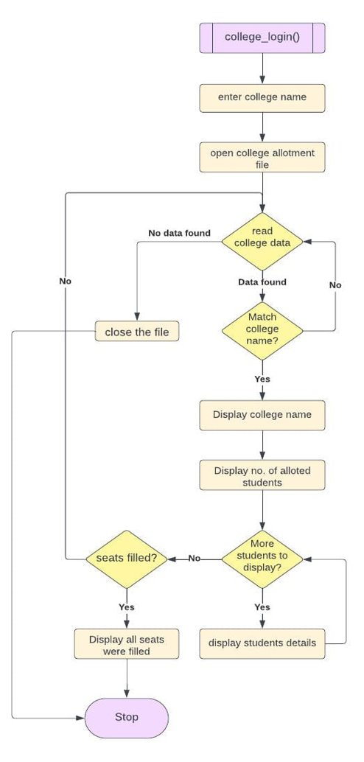
COLLEGE_LOGIN() MODULE

Slide 22
COLLEGE_LOGIN() MODULE
Read the college name from the user.
Open the 'college_allotment.txt' file containing college allotment and student information.
Iterate through the college entries in the file (assumed 16 colleges) and read each college's information into the 'clg' structure using 'fread'.
Check if the entered college name matches the current college's name using case-insensitive comparison with 'strstr' and 'strupr'.
If a match is found, display the college name.
Display the number of students allotted to the branch in the college ('clg.num_stu').
Iterate through the assigned students for that branch and display their information using the 'check_pass' function.
Check if all seats in the branch ('clg.capacity') have been filled.
If the capacity matches the number of students allotted ('clg.num_stu'), display a message indicating all seats have been filled.
If no match is found for the entered college name, display an "Invalid college name" message.
Close the college file and exit the function.

Slide 23
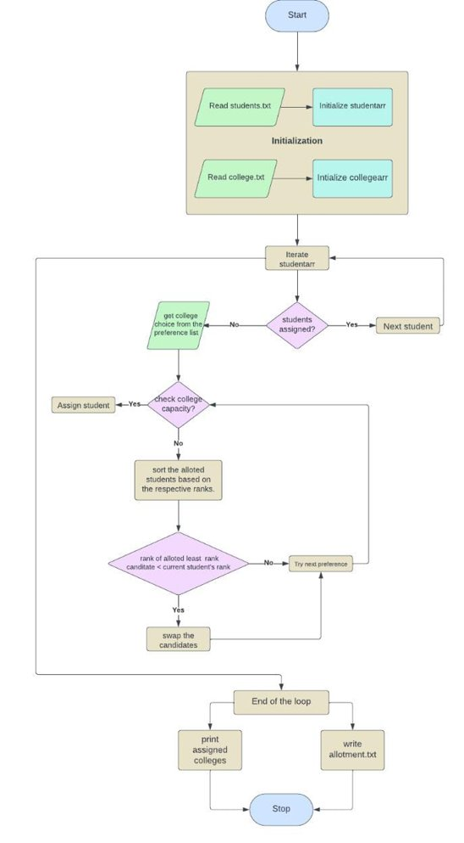
MAIN MODULE

Slide 24
MAIN MODULE
The function declares variables and opens the "studentpreference.txt" file to read student preferences.
Student preferences are read from the file and stored in the "studentarr" array.
The function opens the "college.txt" file to read college information.
College information is read from the file and stored in the "collegearr" array.
Variables and arrays are initialized for further processing.
The function enters a loop for stable matching until all students are assigned.
It checks for unassigned students within the loop.
If an unassigned student is found, it checks if the chosen college has available capacity.
If there is available capacity, the student is assigned to the college.
If there is no available capacity, the function sorts and reassigns students based on preferences.
The student's preferences are updated, and the function writes the allotment information to "Alloted.txt" file.
It writes the college allotment information to the "college_allotment.txt" file.
Finally, the function displays the allotment information to the console.
The function ends.

Slide 25
IMPLEMENTATION
ORGANISATION OF DATA
ARRAY | STRUCTURES | ARRAY OF STRUCTURES | FILES
Arrays are used to store data related to preferences, assigned students, and other information. For example, the ‘pref’ array in the ‘Student’ structure stores the preferences of a student, and the ‘assigned_stu’ array in the ‘College’ structure stores the names of students assigned to a particular branch in a college. | Structures are used to define custom data types that encapsulate related information. The ‘Student’ structure stores information about a student, including their name, preferences, assigned branch, and next choice. The ‘College’ structure stores information about a college, including its name, capacity, assigned students, and the number of students allotted to a branch. | An array of structures is used to store multiple instances of the same structure type. In this code, an array of ‘Student’ structures (studentarr) and an array of ‘College’ structures (collegearr) are used to store information about multiple students and colleges, respectively. | Files are used for reading and writing data. The code reads data from files like "studentpreference.txt", "Allotment.txt", and "college_allotment.txt". It also writes the allocated seats and assigned students to the "Allotment.txt" file.

Slide 26
LIBRARIES |  |  |  | APIs
stdio.h | string.h | stdlib.h | strings.h | functions.h
Provides input/output functions like printf and scanf. | Provides string manipulation functions like strcpy and strcmp. | Provides general-purpose functions like atoi and fclose. | Provides additional string manipulation functions like strupr. | The "functions.h" header file likely contains function prototypes and definitions for various operations related to student and college preferences, password checking, file handling, and more. The actual content of this header file is not provided in the code snippet.

Slide 27
USER INTERFACE DESIGN
The user interface design in the code is based on console input/output.
Students are prompted to enter their name and password for login. They are then provided with options for choice filling, allocation, or preference changing.
College admins are prompted to enter the college name for login. They are then shown the number of students allocated to each branch in their college.
Platform used for Code Development: Dev C++

Slide 28
ADVANTAGES
SORTING ADVANTAGE:
The advantage is that only when there is a need for the comparison of the ranks of already allotted least rank candidate and the present(current) candidate ,the sorting takes place .
This reduces the time complexity.
ADVANTAGE OF STRUCTURES:
Usage of structures helps to store the whole student's details containing block as a whole in the file...
USER FRIENDLY:
The inputs can be of any case (i.e) irrespective of the cases the code takes the inputs without showing error.

Slide 29
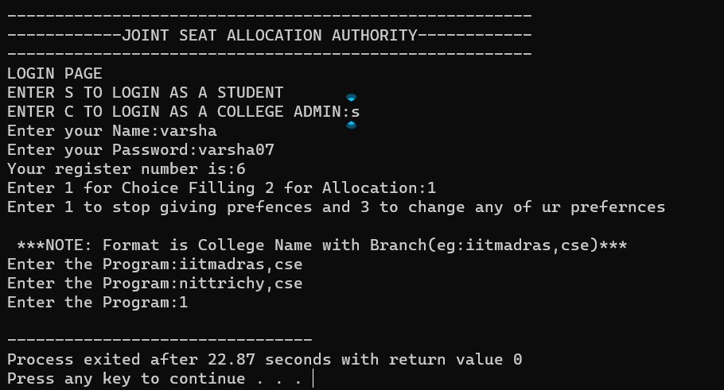
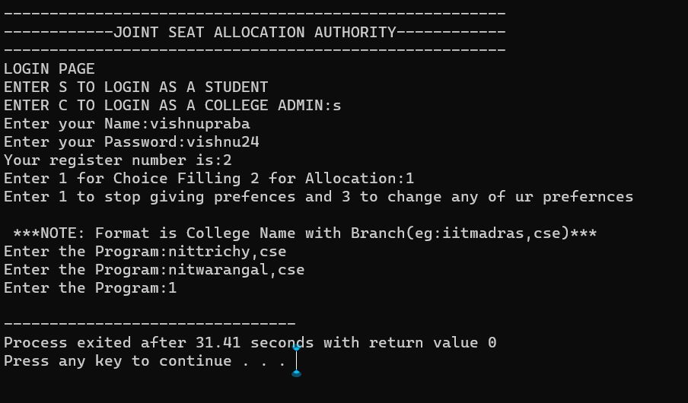
DETAILED TEST CASES
TEST CASE 1:
INPUT:

Slide 30
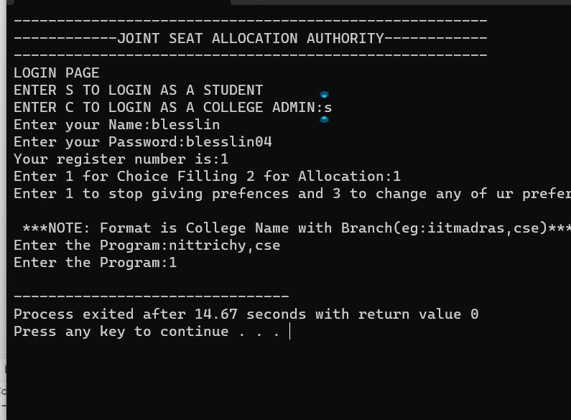
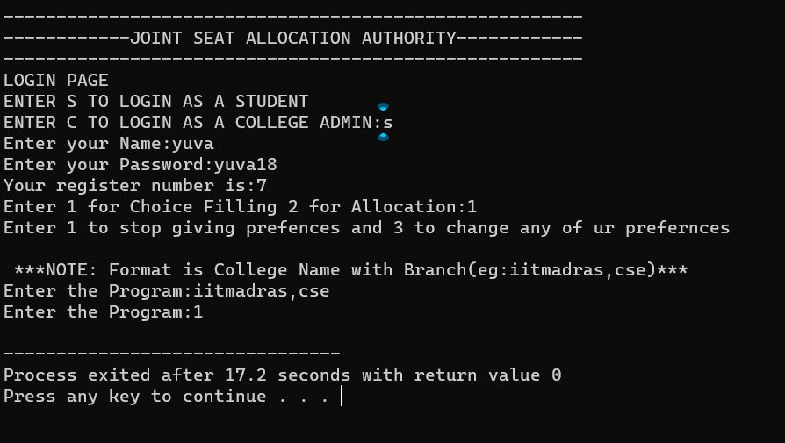
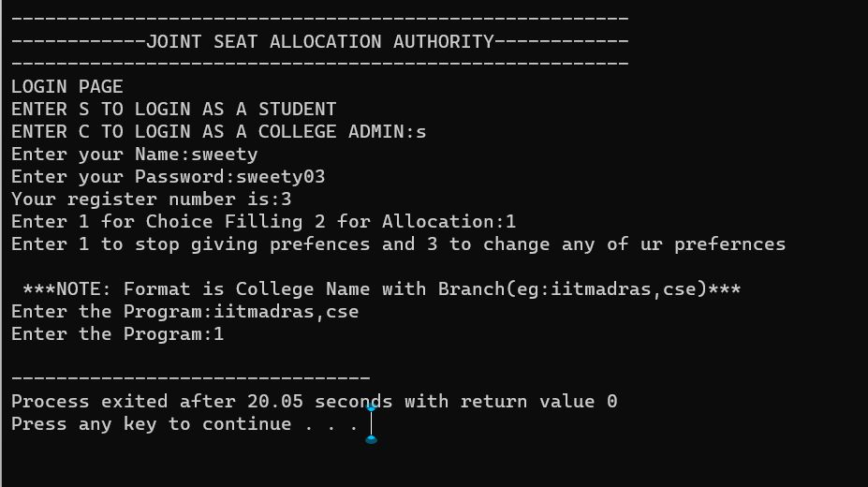

Slide 31
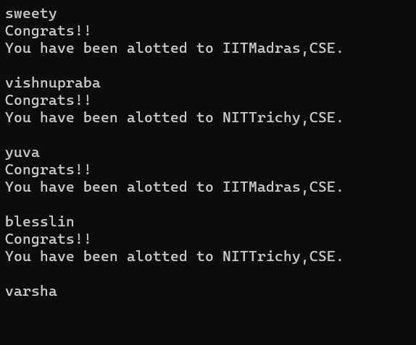
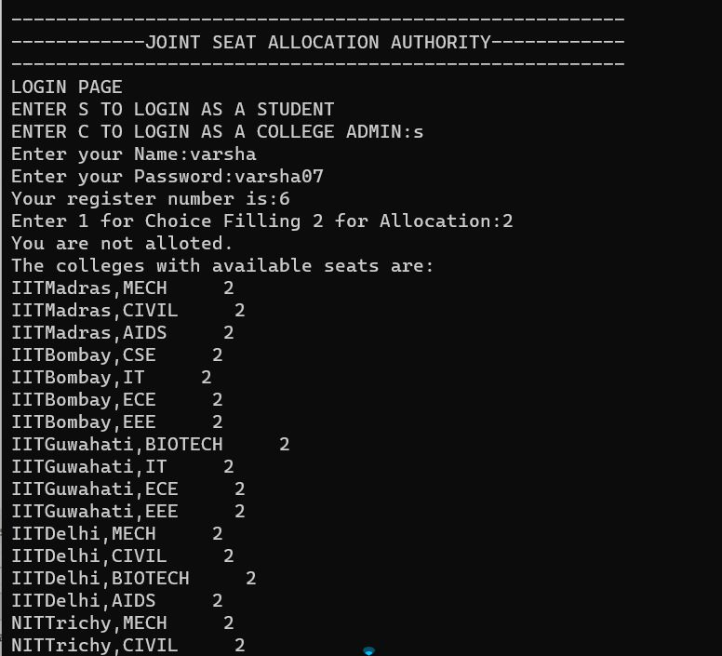
OUTPUT:

Slide 32
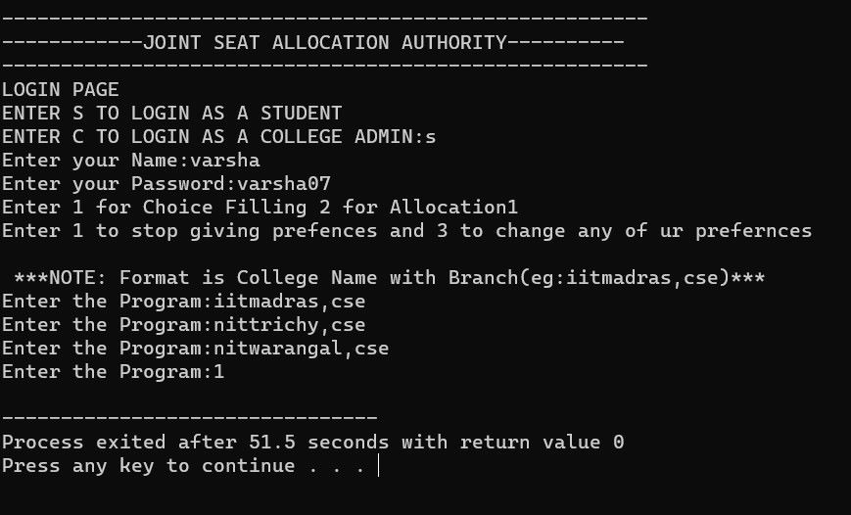
TEST CASE 2:
INPUT:

Slide 34
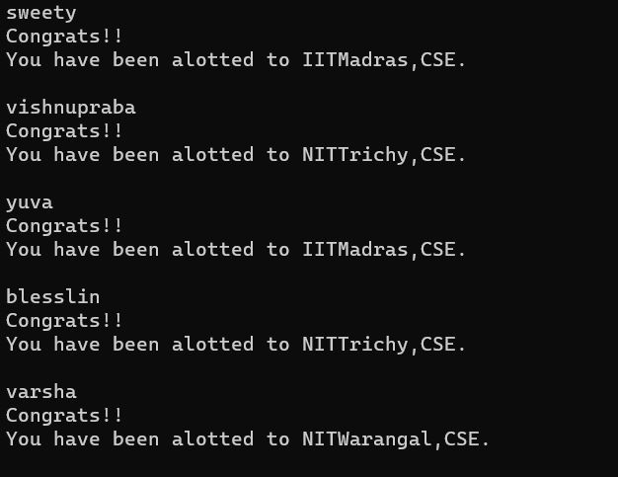
OUTPUT:

Slide 35
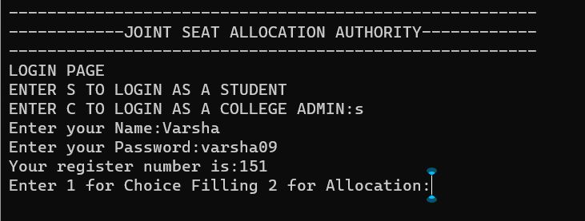
USER FRIENDLY TEST CASES
TEST CASE 1:

Slide 36
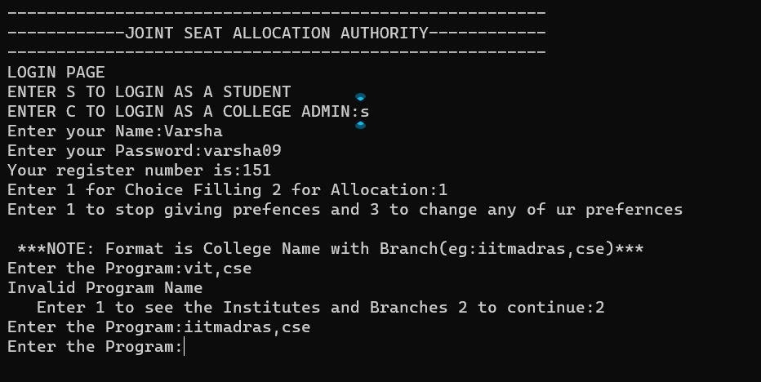
TEST CASE 2:

Slide 37
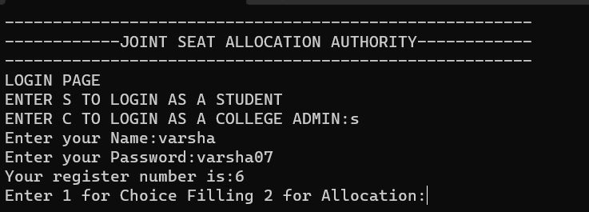
TEST CASE 3:

Slide 38
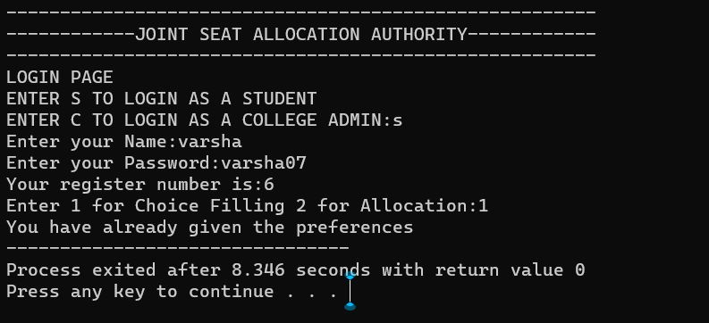
TEST CASE 4:

Slide 39
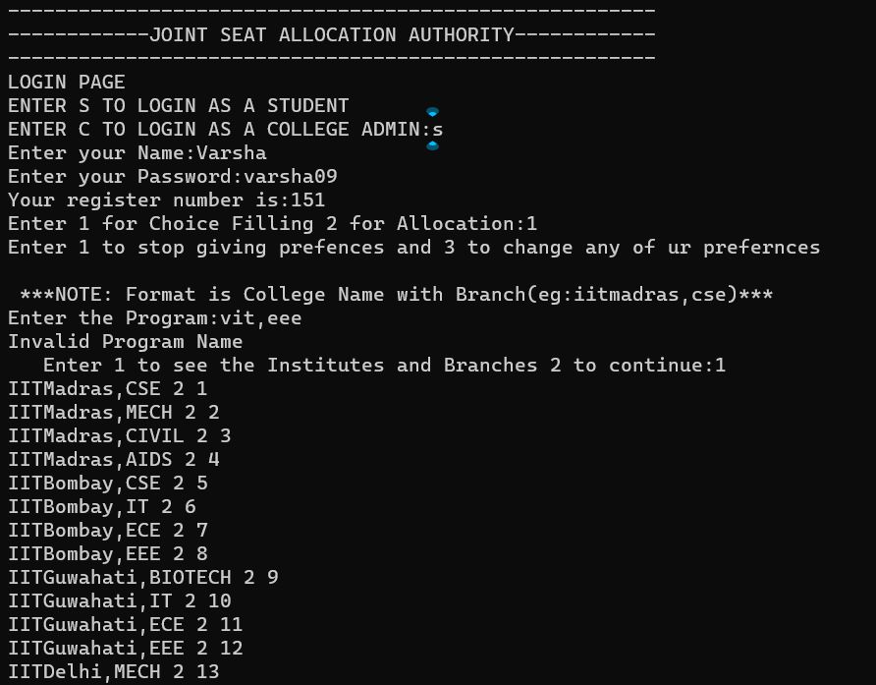
TEST CASE 5:

Slide 40
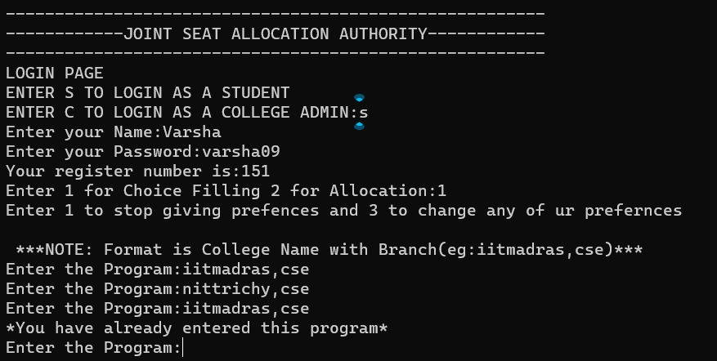
TEST CASE 6:

Slide 41
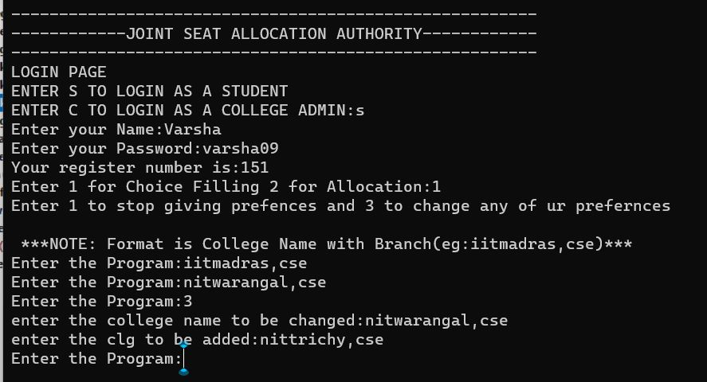
TEST CASE 7:

Slide 42
TEST CASE 8:

Slide 43
TEST CASE 9:

Slide 44
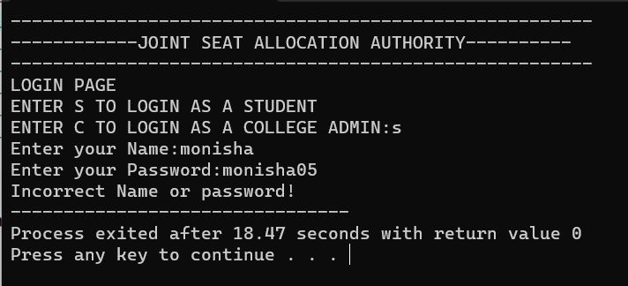
TEST CASE 10:

Slide 45
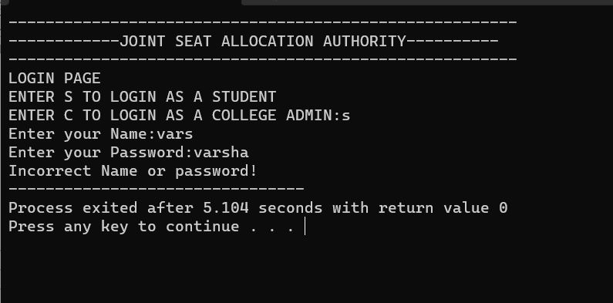
TEST CASE 11:

Slide 46
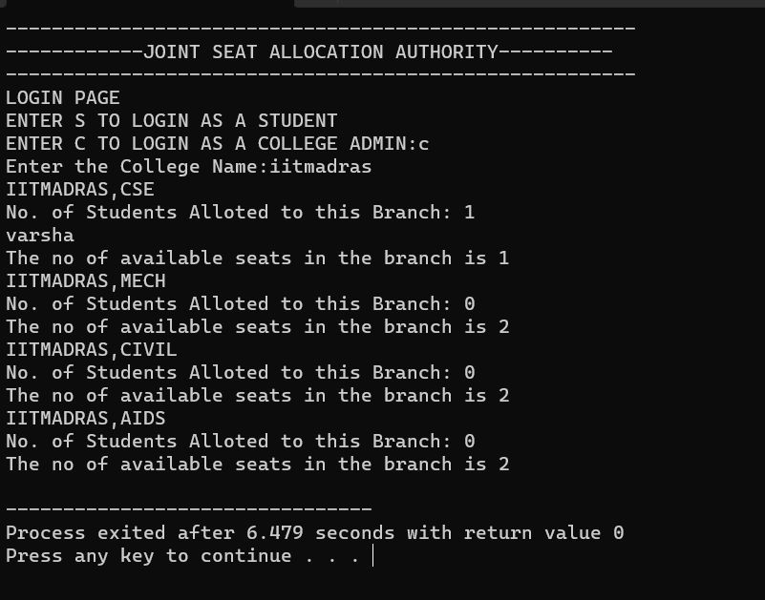
TEST CASE 12:

Slide 47
LIMITATIONS OF THE SOLUTIONS
While the deferred acceptance algorithm is a powerful tool for joint seat allocation, it is not without its challenges and limitations.
The Main challenge is the need for accurate and reliable data, which can be difficult to obtain in practice.
Since we are using file handling instead of database, writing and reading data from the files takes more time relatively.
These challenges and limitations must be carefully considered when designing and implementing a joint seat allocation system.

Slide 48
OBSERVATIONS FROM THE SOCIETAL, LEGAL, ENVIRONMENTAL AND ETHICAL PERSPECTIVES
We have considered various perspectives to ensure a holistic solution.
From a societal standpoint, our solution focuses on fairness, transparency, and equal opportunities in the admission process.
Ensuring a User-friendly system

Slide 49
THANK YOU!

